Slide 1
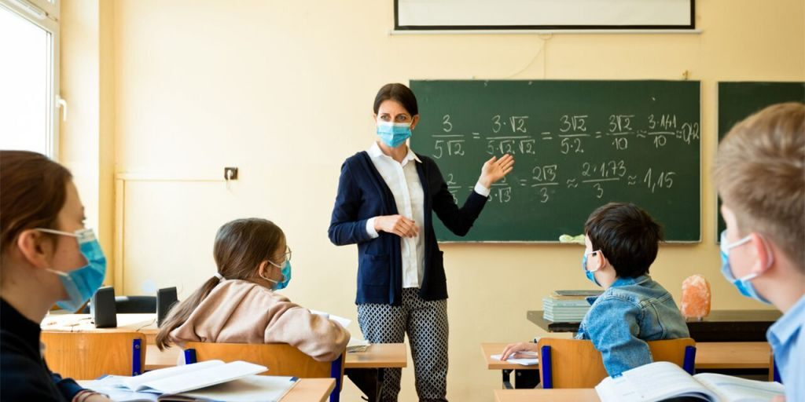
Keynote Address
"The Impact of the Coronavirus on our Children and our Schools"
Illinois Council for Children with Behavioral Disorders
Dr. Dean Cantu
Associate Dean and Director, Department of Education, Counseling, & Leadership
Bradley University

Slide 2
COVID-19
Coronavirus Pandemic

Slide 3
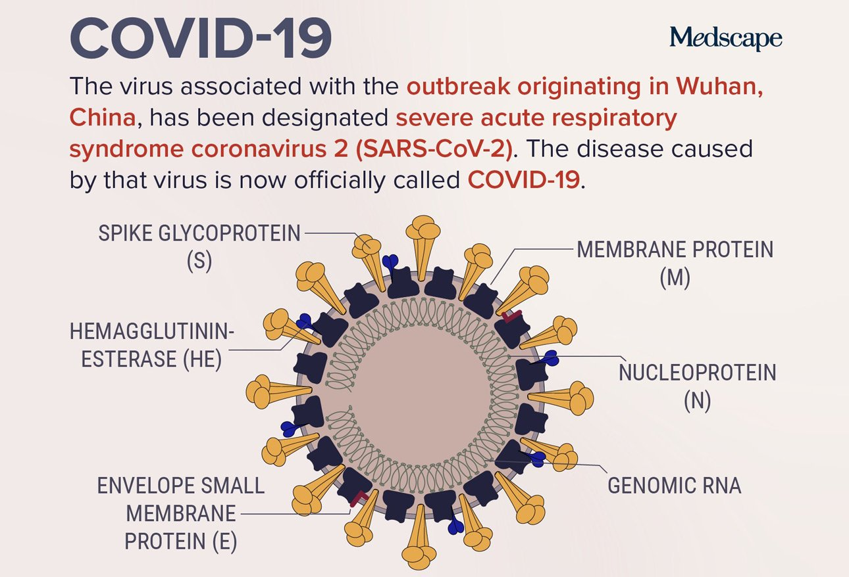
https://www.medscape.com/slideshow/covid-19-infographics-6012689

Slide 4
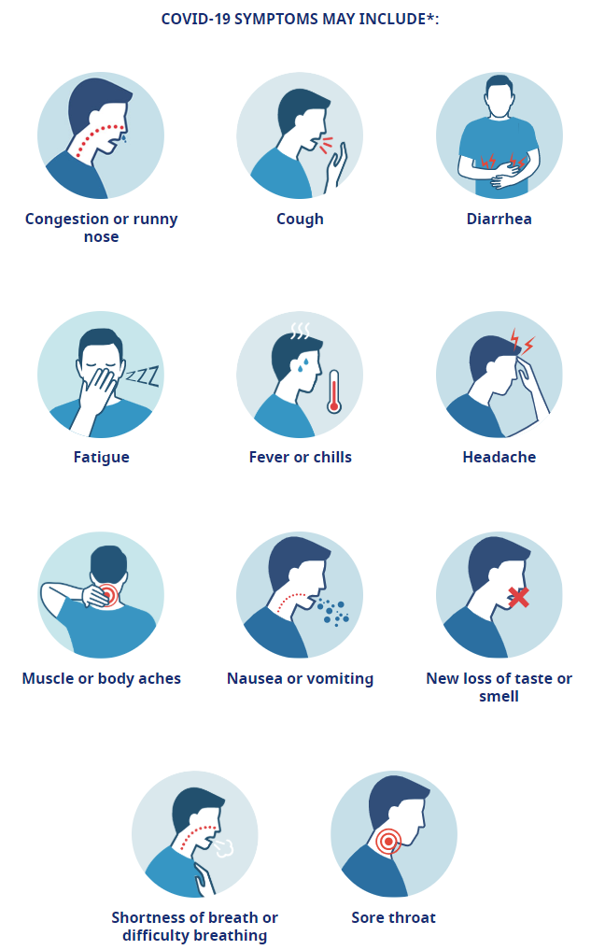
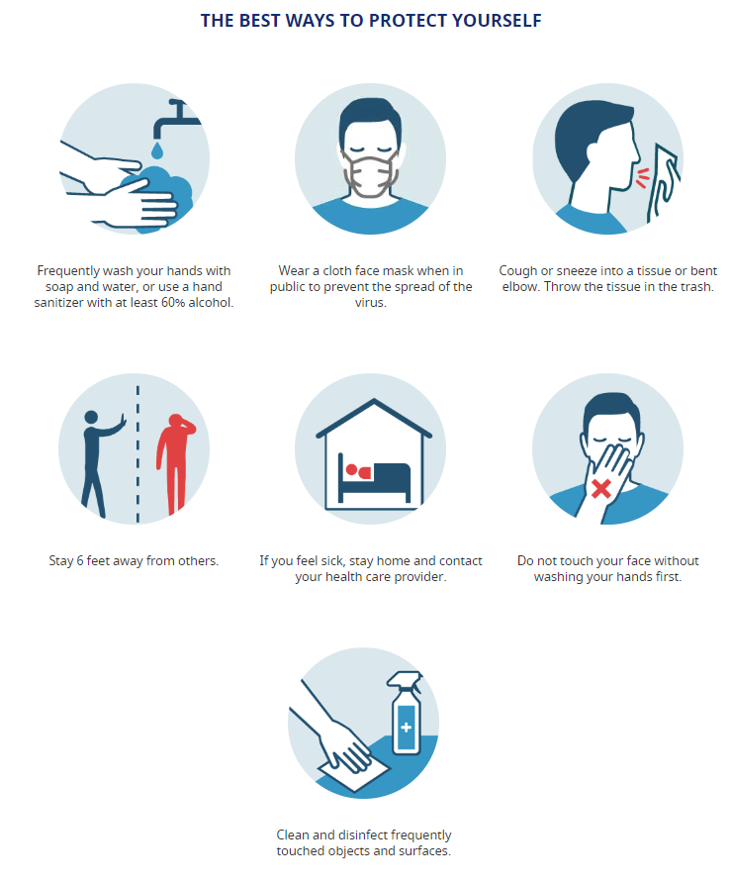
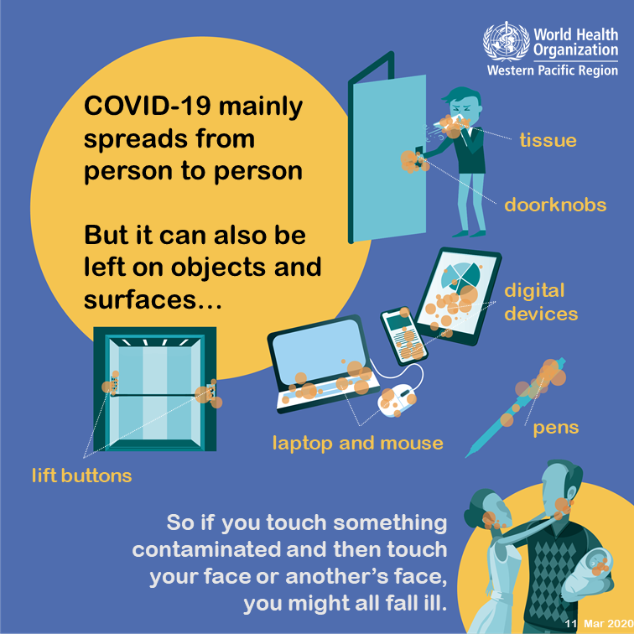
https://www.hopkinsmedicine.org/health/conditions-and-diseases/coronavirus/coronavirus-facts-infographic
https://www.who.int/westernpacific/emergencies/covid-19/information/transmission-protective-measures

Slide 5
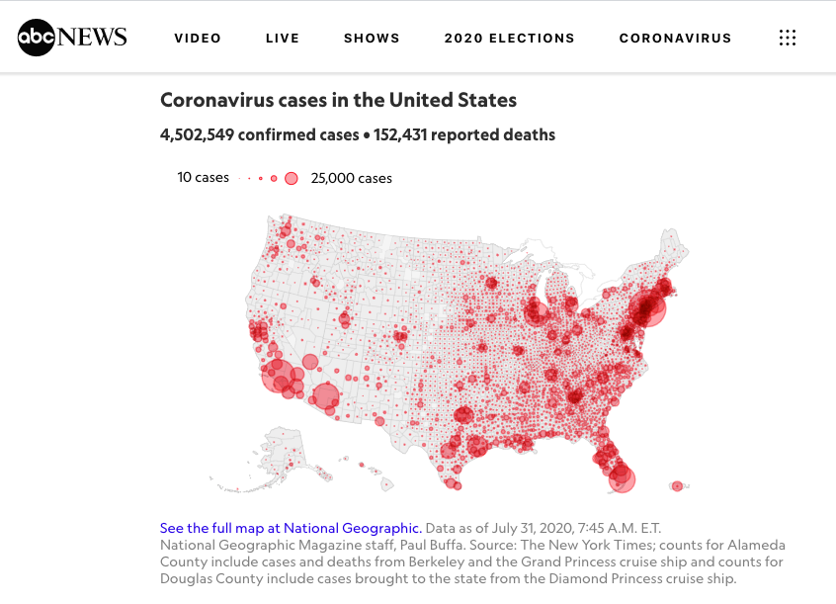
https://abcnews.go.com/Health/coronavirus-map-tracking-spread-us-world/story?id=69415591

Slide 6
https://abcnews.go.com/Health/coronavirus-map-tracking-spread-us-world/story?id=69415591

Slide 7
https://www.cdc.gov/covid-data-tracker/index.html#cases

Slide 8
https://informationisbeautiful.net/visualizations/covid-19-coronavirus-infographic-datapack/

Slide 9
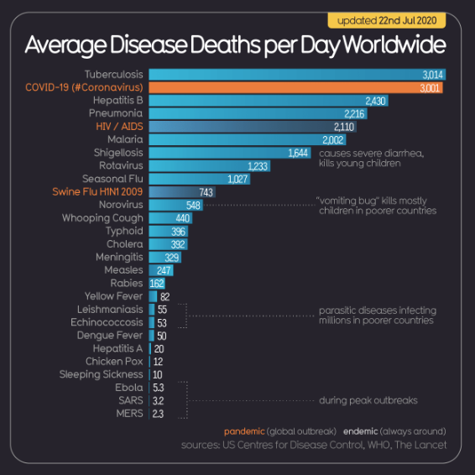
https://informationisbeautiful.net/visualizations/covid-19-coronavirus-infographic-datapack/

Slide 10
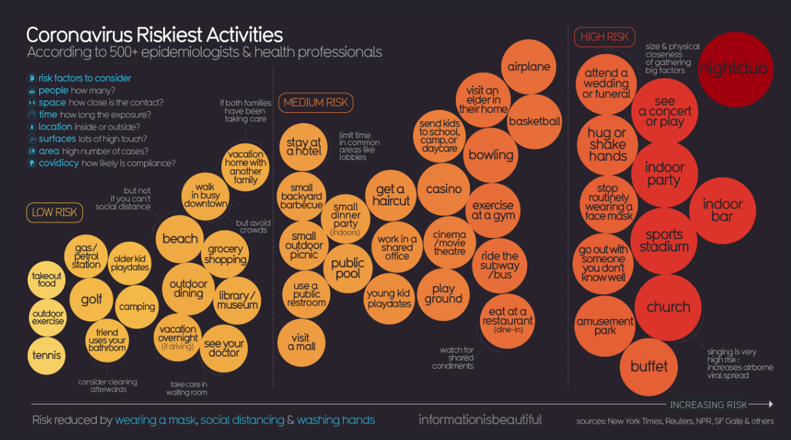
https://informationisbeautiful.net/visualizations/covid-19-coronavirus-infographic-datapack/

Slide 11
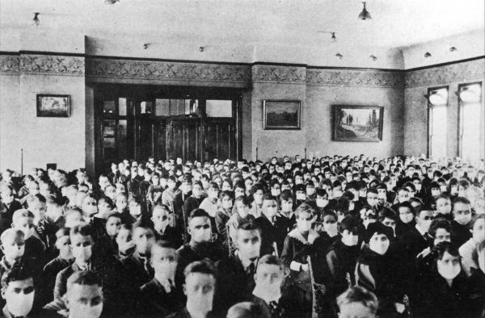
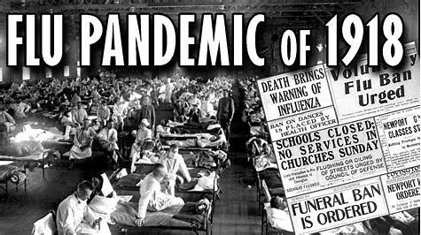
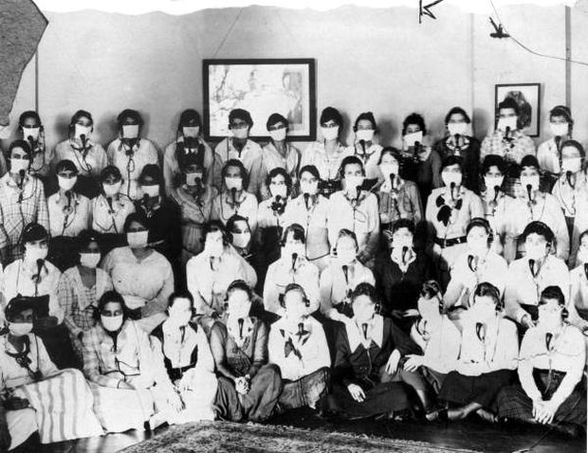
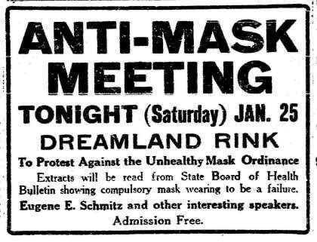
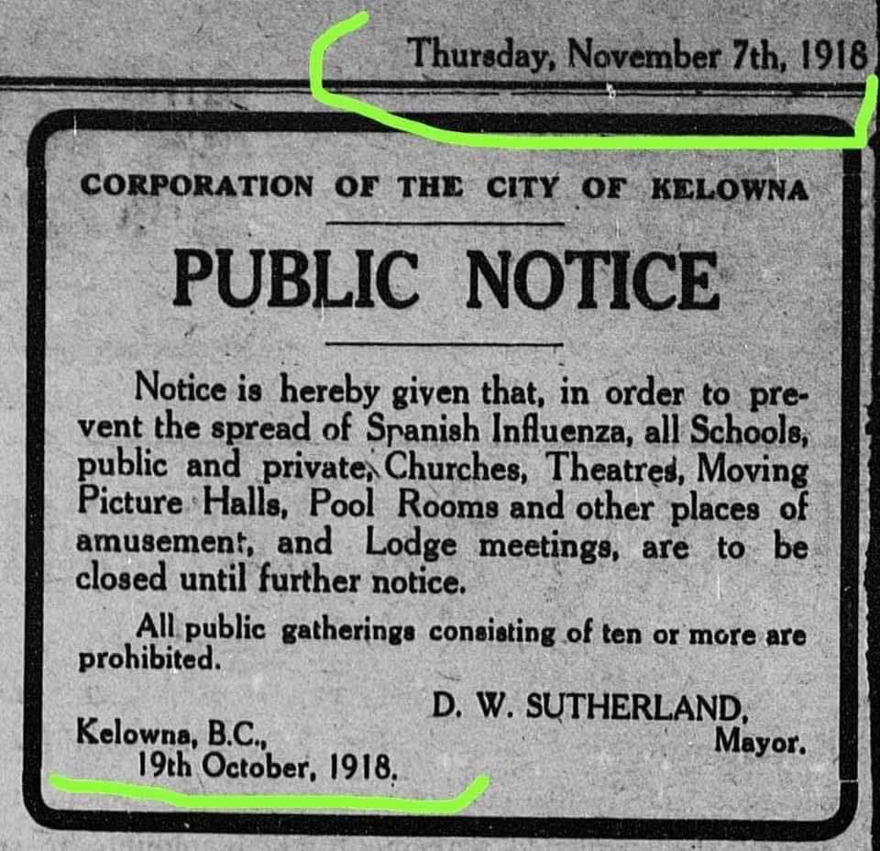
Spanish Flu
Flu Pandemic of 1918-1919

Slide 12
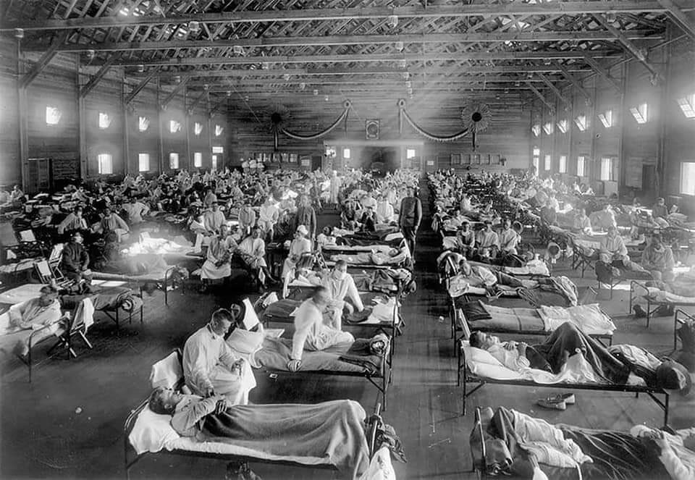
An estimated 650,000 Americans lost their lives to the infamous and tragic 1918-1919 influenza epidemic, a small but significant fraction of the approximately 50 million deaths the disease caused worldwide.
https://quod.lib.umich.edu/cgi/t/text/idx/f/flu?type=simple&q1=School%20Board&rgn=subject

Slide 13
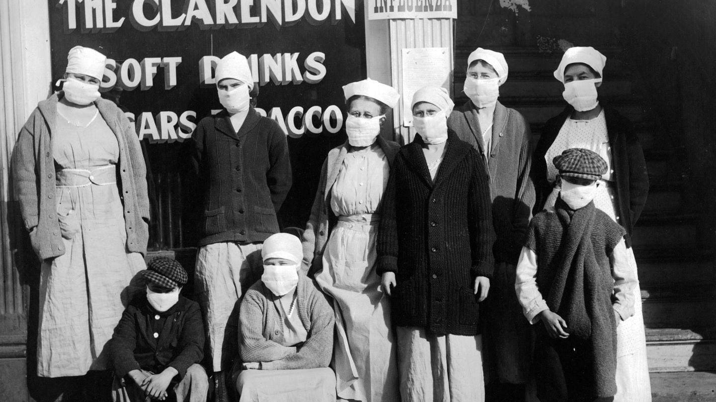
Baltimore American
October 8, 1918, p. 14
https://quod.lib.umich.edu/f/flu/4420flu.0000.244

Slide 14
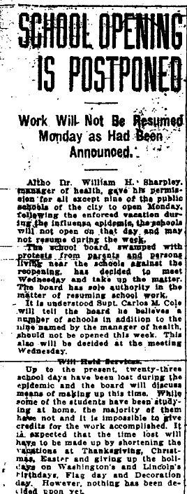
Rocky Mountain News
November 9, 1918, p. 4
http://hdl.handle.net/2027/spo.6680flu.0003.866

Slide 15
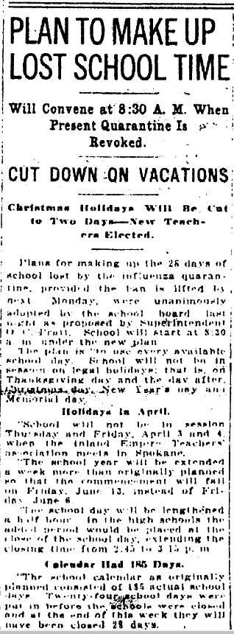
The Spokesman-Review
Spokane, Washington
November 12, 1918, p. 7
https://quod.lib.umich.edu/f/flu/8620flu.0011.268

Slide 16
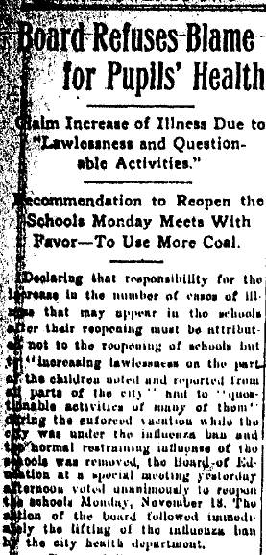
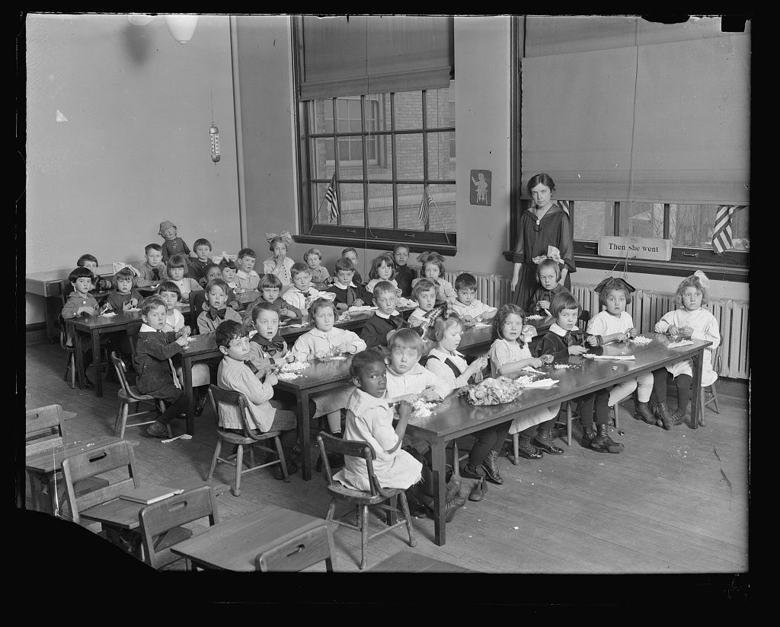
Minneapolis Morning Tribune
November 16, 1918, p. 22
https://www.washingtonpost.com/lifestyle/kidspost/school-during-the-1918-spanish-flu-pandemic/2020/05/12/7d606c90-7f32-11ea-9040-68981f488eed_story.html
https://quod.lib.umich.edu/f/flu/6540flu.0006.456

Slide 17
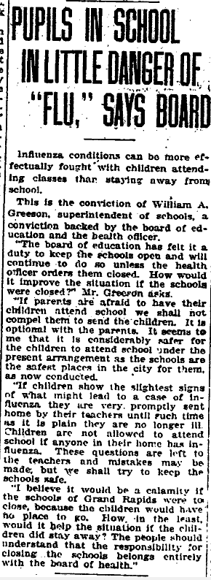
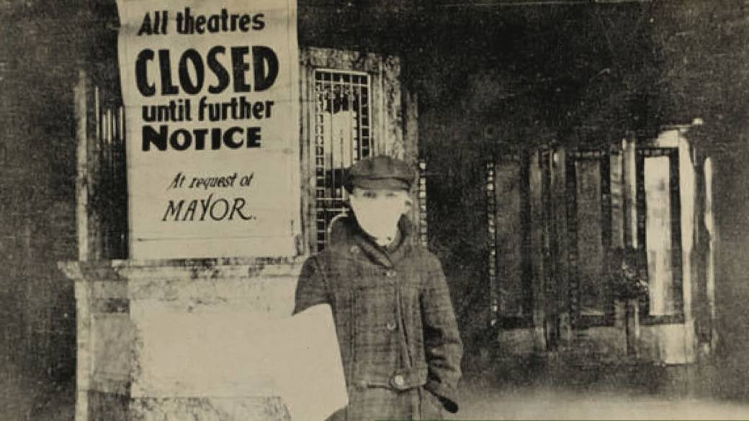
Grand Rapids Herald
December 9, 1918, p. 3
https://quod.lib.umich.edu/f/flu/9070flu.0004.709

Slide 18
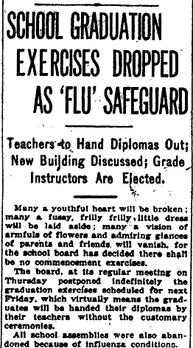
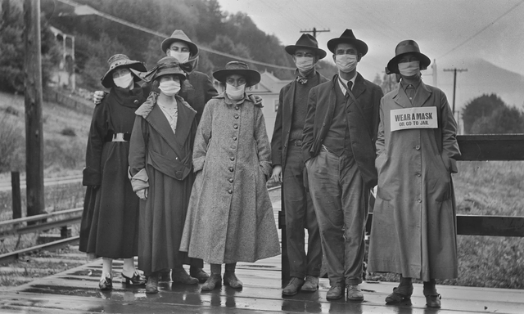
Oregon Daily Journal
January 17, 1919, p. 6
https://quod.lib.umich.edu/f/flu/5510flu.0008.155

Slide 19
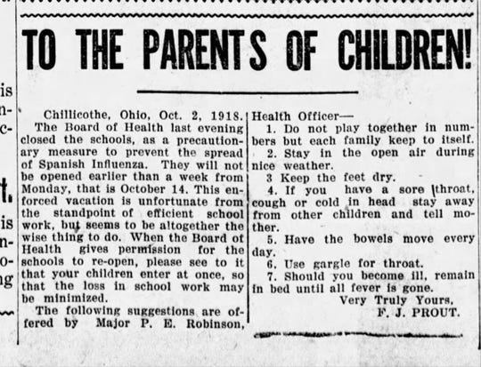
I had a little bird,
Its name was Enza.
I opened the window,
And in-flu-enza.
During the Spanish Influenza outbreak of 1918, children often sang this popular nursery rhyme to the melody of “Ring Around the Rosie” while jumping rope.
Chillicothe Gazette on Wednesday, Oct 2 1918 - letter from then Superintendent of Schools F.J. Prout.
https://www.chillicothegazette.com/story/news/2020/03/31/1918-spanish-influenza-and-schools/5093316002/

Slide 20
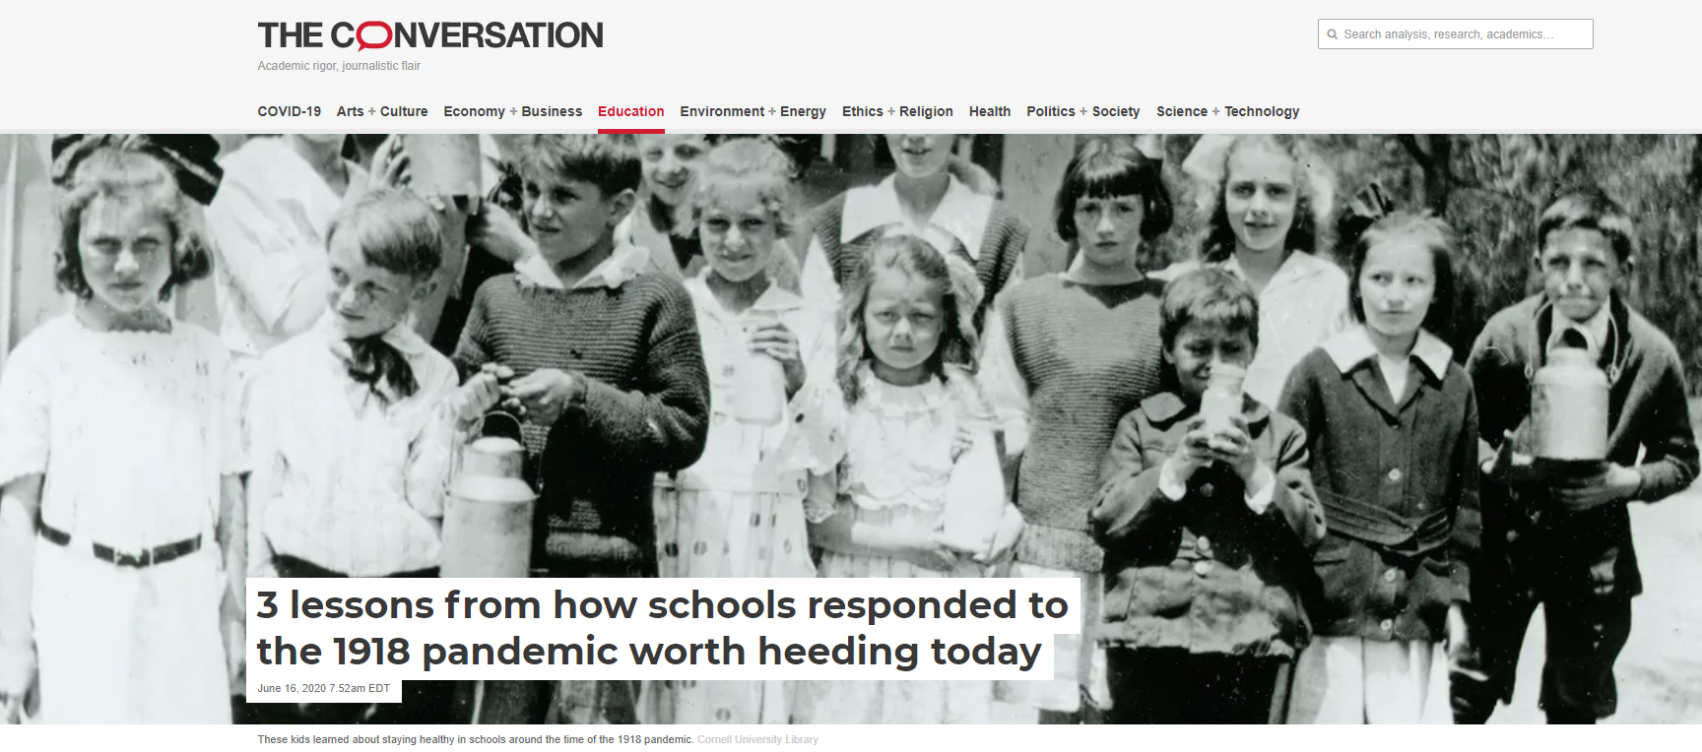
https://theconversation.com/3-lessons-from-how-schools-responded-to-the-1918-pandemic-worth-heeding-today-138403

Slide 21
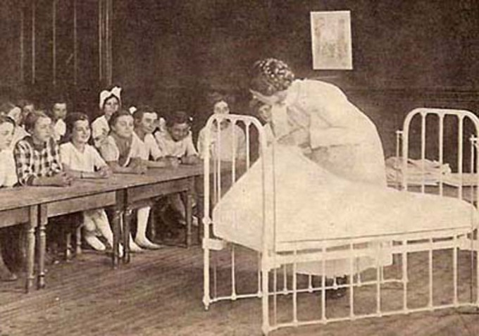
1. Invest in school nurses
School nurses were transformative when they were first introduced in 1902.
Rather than simply send sick students home, where they would miss school while receiving no treatment, nurses cared for children’s illnesses and provided health information to their families.
After a study showed that nurses cut student absences in half, more and more cities funded them. Within 11 years of the first nurse being hired, nearly 500 U.S. cities employed school-based medical professionals.
https://theconversation.com/3-lessons-from-how-schools-responded-to-the-1918-pandemic-worth-heeding-today-138403

Slide 22
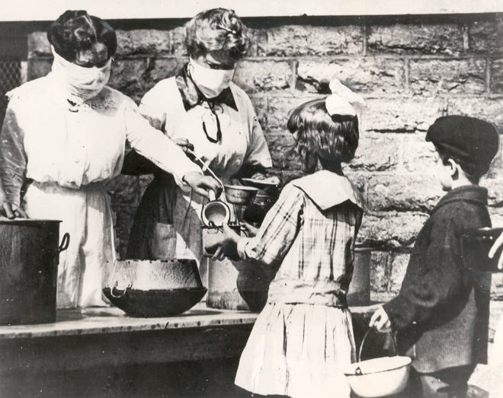
2. Partner with other authorities
A study of schools in 43 cities during the 1918 pandemic identified “planning that brings public health, education officials, and political leaders together” as key to successful responses.
In Los Angeles, the mayor, health commissioner, police chief and school superintendent collaborated to monitor infection rates, provide teachers additional training, and create and deliver homework for 90,000 schoolchildren.
In St. Louis, political, health and education leaders designed a gradual reopening that saw high schools open first, followed a month later, once cases in younger children had dropped, by elementary schools.
https://theconversation.com/3-lessons-from-how-schools-responded-to-the-1918-pandemic-worth-heeding-today-138403

Slide 23
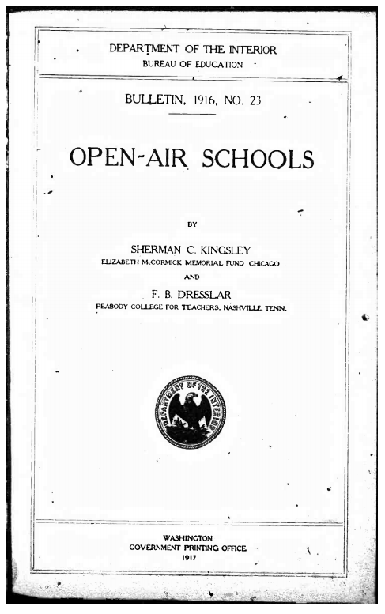
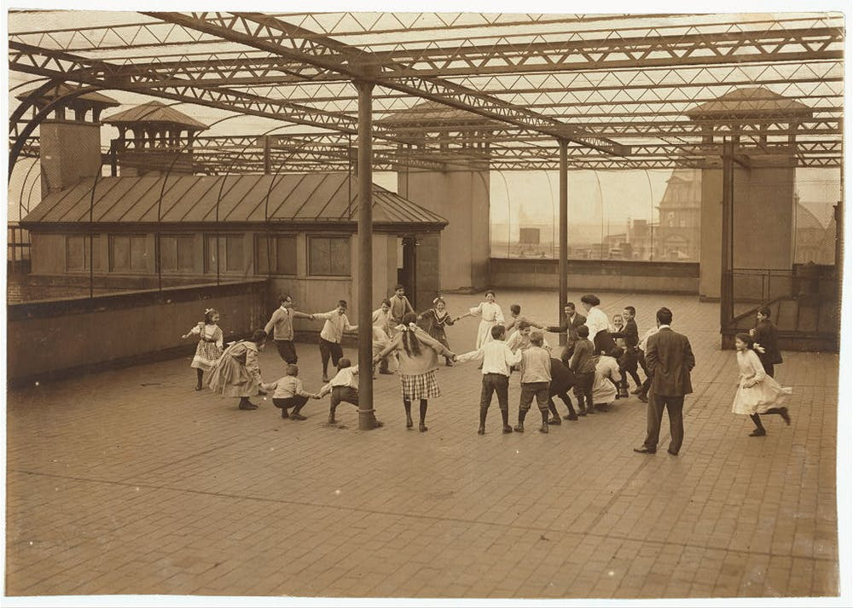
3. Tie education to other priorities
In 1916 the U.S. Bureau of Education proclaimed that the “education of the schools is important, but life and health are more important.”
Progressive reformers took that notion to heart. In addition to school nurses, they established school lunch programs, built playgrounds and promoted outdoor education.
By the time the pandemic hit, schools stood ready to deliver not only lessons but food and health care.
When schools reopened, children could learn in what Copeland described as “large, clean, airy school buildings” with outdoor spaces.
https://theconversation.com/3-lessons-from-how-schools-responded-to-the-1918-pandemic-worth-heeding-today-138403

Slide 24
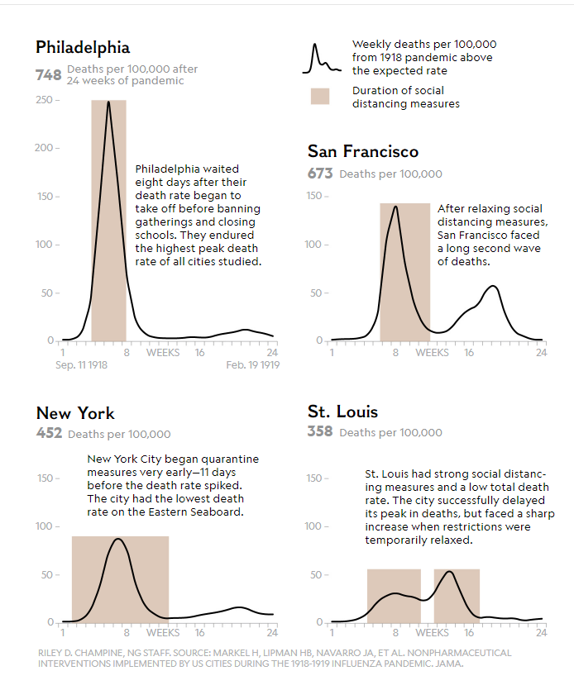
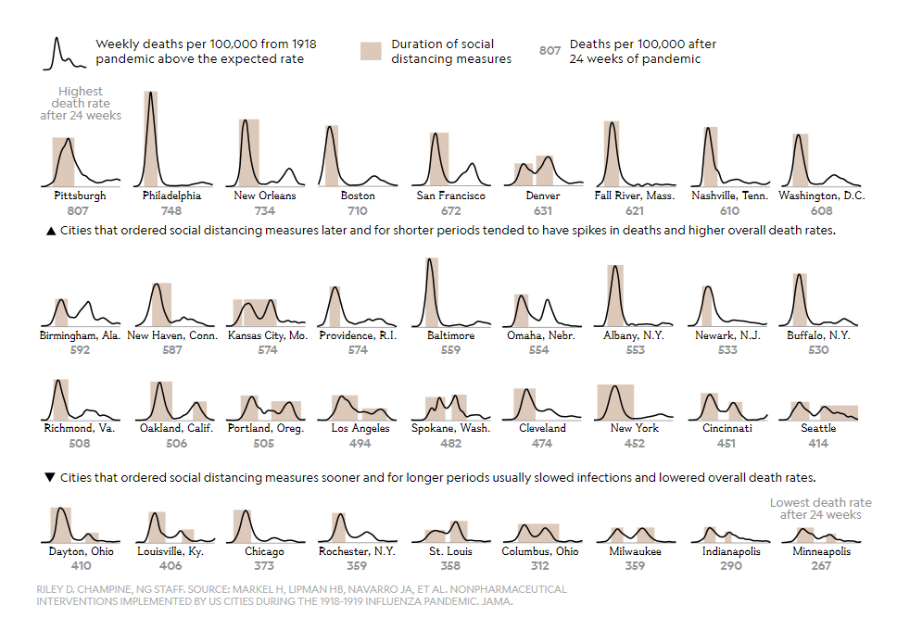
https://www.nationalgeographic.com/history/2020/03/how-cities-flattened-curve-1918-spanish-flu-pandemic-coronavirus/

Slide 25
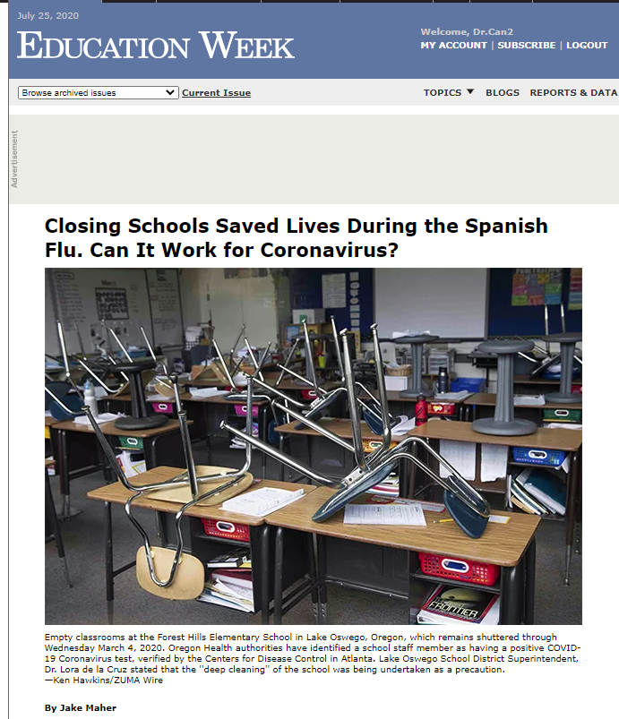
https://www.edweek.org/ew/articles/2020/03/04/closing-schools-saved-lives-during-the-spanish.html

Slide 26
Closing American schools earlier and for a longer period of time blunted the impact of the Spanish Flu. In that global pandemic, at least 50 million people died worldwide, including 675,000 in the United States, according to the Centers for Disease Control and Prevention.
Navarro and other scholars studied how 43 cities across the country responded to the Spanish Flu from 1918 to 1919. They found that cities that early on enacted “non-pharmaceutical interventions,” or NPIs, like school closures or bans on public gatherings, had a lower peak mortality and lower overall morbidity than cities that waited longer to do so.
Most cities “layered” different interventions. For instance, the first line of defense was often self-isolation for infected people or a quarantine. School closure usually only becomes necessary after it is impossible to track how each individual victim was infected.
https://www.edweek.org/ew/articles/2020/03/04/closing-schools-saved-lives-during-the-spanish.html

Slide 27
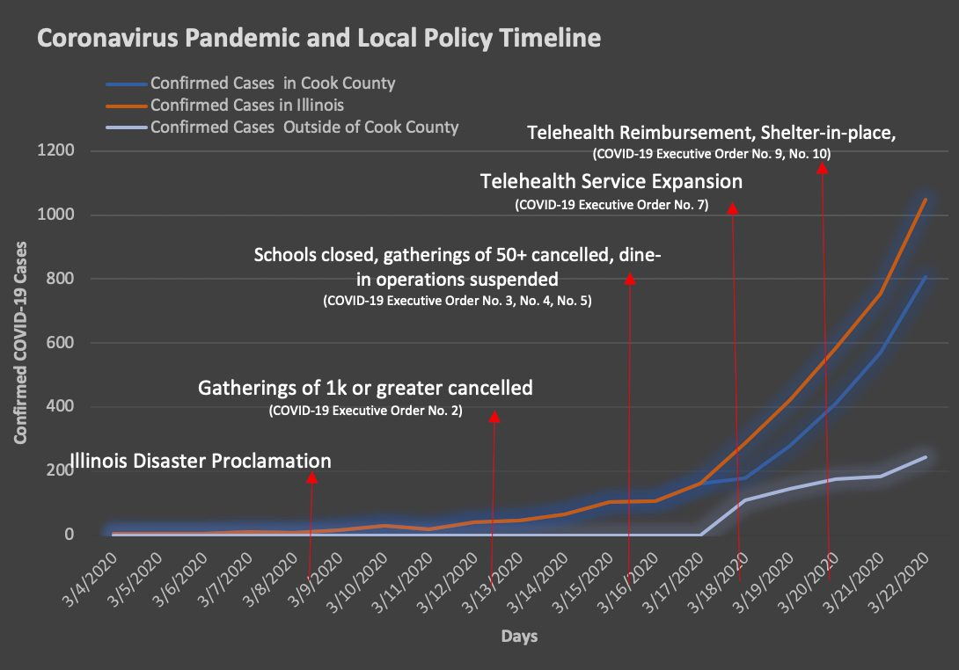
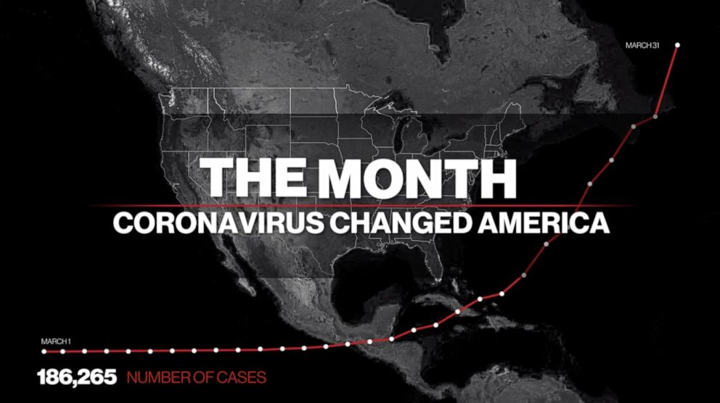
COVID-19
Coronavirus Pandemic of 2020 Historical Timeline

Slide 28
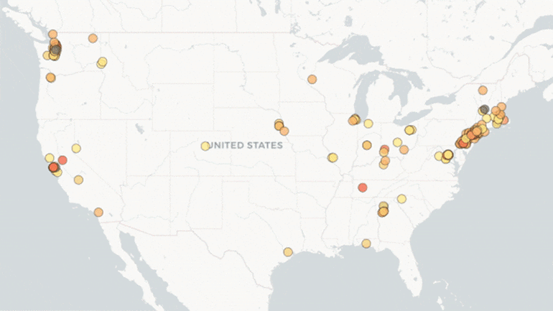
https://www.edweek.org/ew/section/multimedia/the-coronavirus-spring-the-historic-closing-of.html

Slide 29
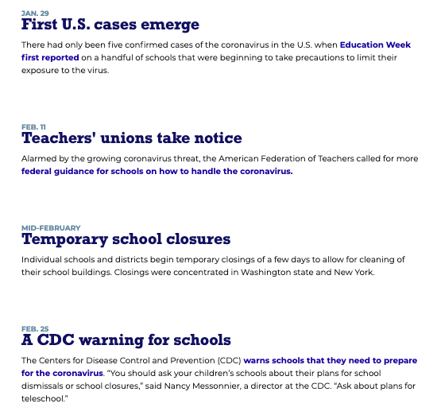
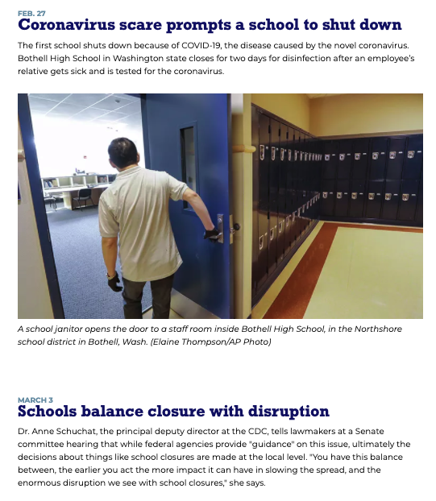
https://www.edweek.org/ew/section/multimedia/the-coronavirus-spring-the-historic-closing-of.html

Slide 30
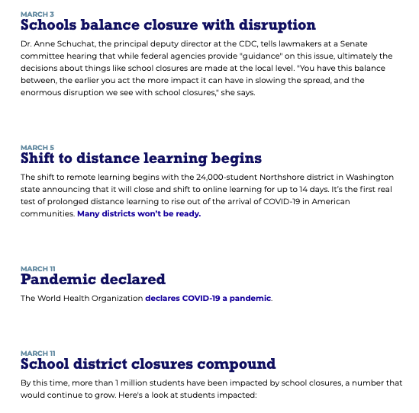
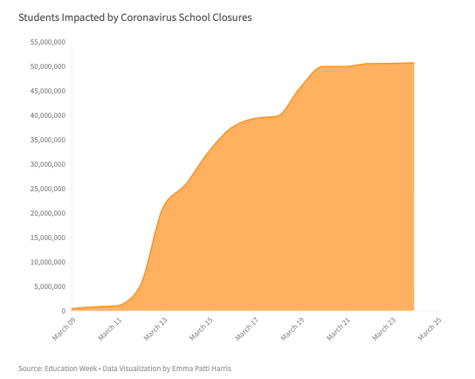
https://www.edweek.org/ew/section/multimedia/the-coronavirus-spring-the-historic-closing-of.html

Slide 31
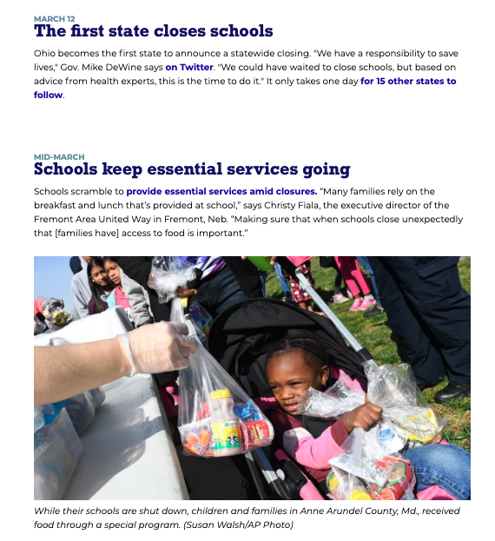
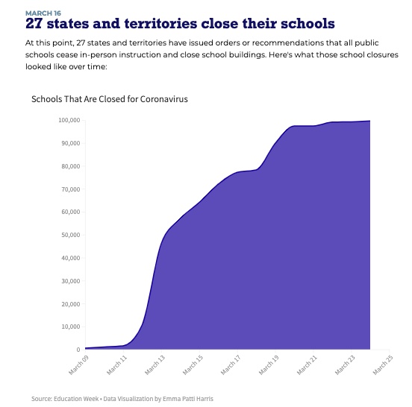
https://www.edweek.org/ew/section/multimedia/the-coronavirus-spring-the-historic-closing-of.html

Slide 32
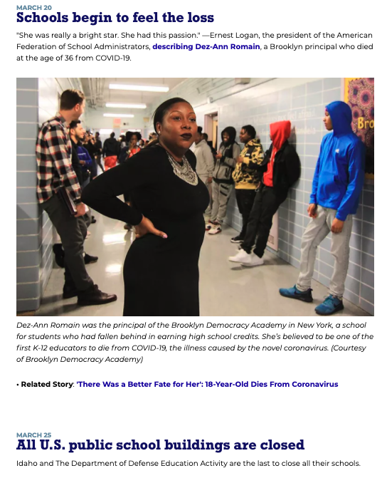
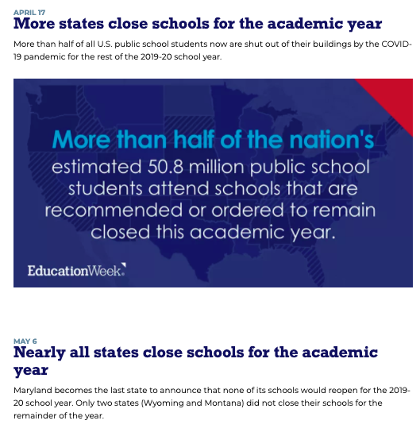
https://www.edweek.org/ew/section/multimedia/the-coronavirus-spring-the-historic-closing-of.html

Slide 33
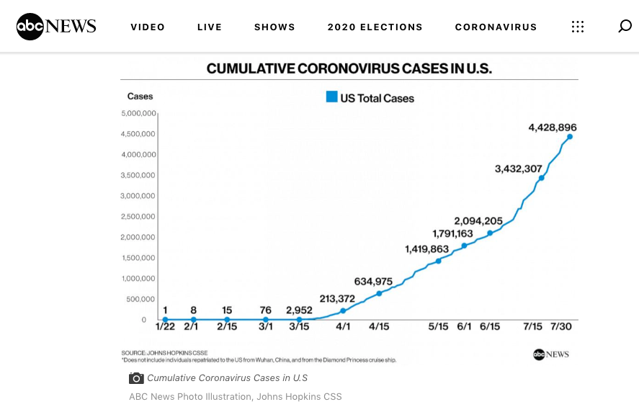
https://abcnews.go.com/Health/coronavirus-map-tracking-spread-us-world/story?id=69415591

Slide 34
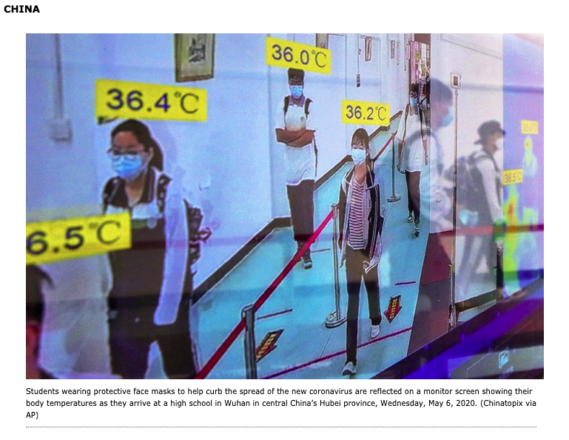
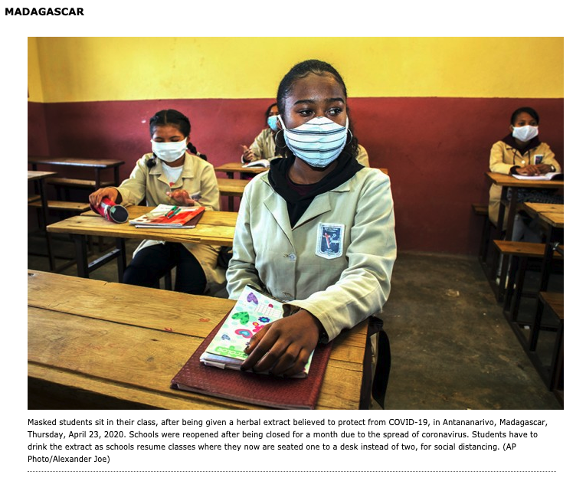
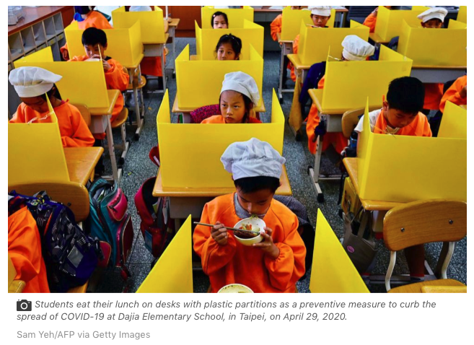
Global Pandemic
Impact of the Coronavirus on Children and Schools Around the World

Slide 35
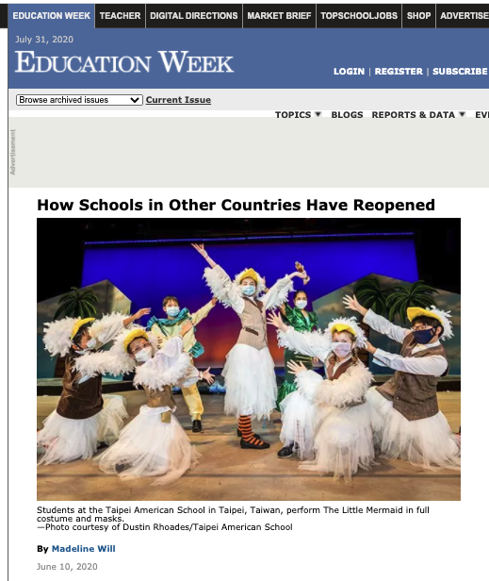
https://www.edweek.org/ew/articles/2020/06/11/how-schools-in-other-countries-have-reopened.html

Slide 36
Taiwan
The Taiwanese government provides all adults nine masks every two weeks, and all children 10 masks every two weeks. During the school year, the private school gives staff members an additional five masks every two weeks so they can have a new mask every day.
The biggest changes have been made in the cafeteria, since students take off their masks to eat. Schools rented tents for the courtyard to expand the eating area. Gone are the salad bars and buffet lines. Meals are now pre-packaged and sealed, and students are handed their lunch by a cafeteria worker so they’re not touching anything.
Students are still allowed to play during recess with masks on. Teachers remind students to take a break and drink water, so they don’t overheat. They call it a “chin break,” when students step away from the other kids and pull their masks down to their chins.
https://www.edweek.org/ew/articles/2020/06/11/how-schools-in-other-countries-have-reopened.html

Slide 37
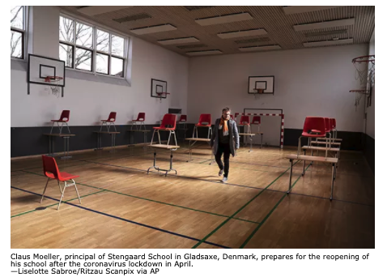
Denmark
Typically, elementary students go to different electives and classes throughout the day. But now, they stay in their “enclave” all day. The single-subject teachers create lessons that either the homeroom teacher will lead or that can be played on the Smartboard. Instead of collaborative seating at tables, students sit at their own desks, which were initially spaced six feet apart.
Students also eat individually packaged lunches in their classrooms, to avoid gathering in the cafeteria. The school has assigned bathrooms and entrance points to the school building to groups of students to prevent bottlenecks. Hand-sanitizing stations are at every entrance and exit. Water fountains have been shut down, and instead there are stations where students can fill their water bottles.
Recess still happens, with social-distancing measures put in place. Classrooms are split into smaller groups of five students each, and students are only allowed to play with the other children in their group. There might be multiple groups of students outside at once, but the children stay in their own bubbles.
https://www.edweek.org/ew/articles/2020/06/11/how-schools-in-other-countries-have-reopened.html

Slide 38
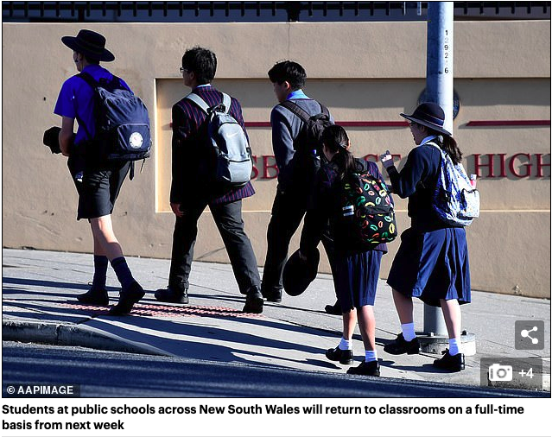
New South Wales
Educators in the Australian state of New South Wales were worried: After schools transitioned to remote learning in March, there was a significant reduction in calls to child protective services. They couldn’t guarantee the safety—or the learning—of some of their most vulnerable students.
To make sure students were regularly seeing their teachers, schools resumed in-person instruction one day a week starting May 11. That way, schools could maintain social distancing without restricting return to only certain grade levels. Students continued with distance learning the other four days. (Even during the shutdown, school buildings weren’t officially closed—but the government encouraged parents to keep their children home if they could).
Individual schools could decide how to manage the rollout. Some had each grade level come in on certain days, while others divided students up alphabetically by their last name. The education department asked that schools consider keeping siblings together to make it easier for families.
https://www.edweek.org/ew/articles/2020/06/11/how-schools-in-other-countries-have-reopened.html

Slide 39
https://abcnews.go.com/International/schools-world-reopening-coronavirus-pandemic/story?id=70641371

Slide 40
https://abcnews.go.com/International/schools-world-reopening-coronavirus-pandemic/story?id=70641371

Slide 41
https://abcnews.go.com/International/schools-world-reopening-coronavirus-pandemic/story?id=70641371

Slide 42
https://abcnews.go.com/International/schools-world-reopening-coronavirus-pandemic/story?id=70641371

Slide 43
https://abcnews.go.com/International/schools-world-reopening-coronavirus-pandemic/story?id=70641371

Slide 44
https://abcnews.go.com/International/schools-world-reopening-coronavirus-pandemic/story?id=70641371

Slide 45
https://abcnews.go.com/International/schools-world-reopening-coronavirus-pandemic/story?id=70641371

Slide 46
http://fullframe.edweek.org/2020/05/07/school-reopening/

Slide 47
http://fullframe.edweek.org/2020/05/07/school-reopening/

Slide 48
http://fullframe.edweek.org/2020/05/07/school-reopening/

Slide 49
http://fullframe.edweek.org/2020/05/07/school-reopening/

Slide 50
http://fullframe.edweek.org/2020/05/07/school-reopening/

Slide 51
http://fullframe.edweek.org/2020/05/07/school-reopening/

Slide 52
http://fullframe.edweek.org/2020/05/07/school-reopening/

Slide 53
http://fullframe.edweek.org/2020/05/07/school-reopening/

Slide 54
http://fullframe.edweek.org/2020/05/07/school-reopening/

Slide 55
http://fullframe.edweek.org/2020/05/07/school-reopening/

Slide 56
http://fullframe.edweek.org/2020/05/07/school-reopening/

Slide 57
http://fullframe.edweek.org/2020/05/07/school-reopening/

Slide 58
http://fullframe.edweek.org/2020/05/07/school-reopening/

Slide 59
COVID-19
Impact on Students and Schools

Slide 60
https://www.weforum.org/agenda/2020/03/infographic-covid19-coronavirus-impact-global-education-health-schools/

Slide 61
https://www.worldbank.org/en/topic/education/publication/simulating-potential-impacts-of-covid-19-school-closures-learning-outcomes-a-set-of-global-estimates

Slide 62
https://www.nwea.org/blog/2020/covid-19-school-closures-could-have-devastating-impact-student-achievement/

Slide 63
https://www.nwea.org/blog/2020/covid-19-school-closures-could-have-devastating-impact-student-achievement/

Slide 64
https://www.nwea.org/blog/2020/covid-19-school-closures-could-have-devastating-impact-student-achievement/

Slide 65
https://www.edweek.org/ew/articles/2020/04/10/national-survey-tracks-impact-of-coronavirus-on.html

Slide 66
https://www.edweek.org/ew/articles/2020/04/10/national-survey-tracks-impact-of-coronavirus-on.html

Slide 67
https://www.edweek.org/ew/articles/2020/04/10/national-survey-tracks-impact-of-coronavirus-on.html

Slide 68
https://www.edweek.org/ew/articles/2020/04/10/national-survey-tracks-impact-of-coronavirus-on.html

Slide 69
https://www.edweek.org/ew/articles/2020/04/10/national-survey-tracks-impact-of-coronavirus-on.html

Slide 70
Schools Reopening
School’s Out for Summer and then…

Slide 71
https://blogs.edweek.org/teachers/teaching_now/2020/07/anthony_fauci_to_teachers_youll_be_part_of_the_experiment_in_reopening_schools.html?intc=main-mpsmvs

Slide 72
https://www.usnews.com/news/education-news/articles/2020-06-09/new-estimate-to-reopen-schools-after-coronavirus-1165-billion
https://www.future-ed.org/what-congressional-covid-funding-means-for-k-12-schools/

Slide 73
https://www.edweek.org/ew/section/multimedia/map-covid-19-schools-open-closed.html?cmp=eml-enl-tl-mostpop&M=59632511&U=1109863&UUID=c1eb80162fc0b461c50781d961f7e562

Slide 74
https://www.edweek.org/ew/section/multimedia/map-covid-19-schools-open-closed.html?cmp=eml-enl-tl-mostpop&M=59632511&U=1109863&UUID=c1eb80162fc0b461c50781d961f7e562

Slide 75
Aside from a child’s home, no other setting has more influence on a child’s health and well-being than their school. The in-person school environment does the following:
provides educational instruction;
supports the development of social and emotional skills;
creates a safe environment for learning;
addresses nutritional needs; and
facilitates physical activity.
https://www.cdc.gov/coronavirus/2019-ncov/community/schools-childcare/reopening-schools.html

Slide 77
https://www.rsnlt.com/wp-content/uploads/2020/07/Return-to-School-Work-Flowchart-July-31-2020.pdf
https://www.edweek.org/ew/section/multimedia/responding-to-coronavirus-downloadable-guide-for-schools.html

Slide 78
https://www.edweek.org/ew/section/multimedia/school-buildings-and-social-distancing-downloadable-guide.html

Slide 79
https://www.who.int/docs/default-source/coronaviruse/key-messages-and-actions-for-covid-19-prevention-and-control-in-schools-march-2020.pdf?sfvrsn=baf81d52_4&gclid=CjwKCAjw0_T4BRBlEiwAwoEiAWu5rReVJzvNvBIHwt-PCC60duHrr8Spn5Znhcs_lusny7vjlt5G9xoCOeoQAvD_BwE

Slide 80
https://www.who.int/docs/default-source/coronaviruse/key-messages-and-actions-for-covid-19-prevention-and-control-in-schools-march-2020.pdf?sfvrsn=baf81d52_4&gclid=CjwKCAjw0_T4BRBlEiwAwoEiAWu5rReVJzvNvBIHwt-PCC60duHrr8Spn5Znhcs_lusny7vjlt5G9xoCOeoQAvD_BwE

Slide 81
https://www.cdc.gov/coronavirus/2019-ncov/community/schools-childcare/index.html

Slide 82
https://www.cdc.gov/coronavirus/2019-ncov/community/schools-childcare/schools.html

Slide 83
https://www.cdc.gov/coronavirus/2019-ncov/community/schools-childcare/schools.html

Slide 84
https://www.cdc.gov/coronavirus/2019-ncov/downloads/community/School-Admin-K12-readiness-and-planning-tool.pdf

Slide 85
https://www.cdc.gov/coronavirus/2019-ncov/downloads/community/School-Admin-K12-readiness-and-planning-tool.pdf

Slide 86
https://www.cdc.gov/coronavirus/2019-ncov/downloads/community/School-Admin-K12-readiness-and-planning-tool.pdf

Slide 87
https://www.cdc.gov/coronavirus/2019-ncov/downloads/community/School-Admin-K12-readiness-and-planning-tool.pdf

Slide 88
https://www.cdc.gov/coronavirus/2019-ncov/downloads/community/School-Admin-K12-readiness-and-planning-tool.pdf

Slide 89
https://www.cdc.gov/coronavirus/2019-ncov/community/schools-childcare/parent-checklist.html

Slide 90
https://www.cdc.gov/coronavirus/2019-ncov/community/pdf/Back-to-School-Planning-for-In-Person-Classes.pdf

Slide 91
https://www.isbe.net/Documents/Part-3-Transition-Planning-Phase-4.pdf

Slide 92
https://www.isbe.net/Documents/Part-3-Transition-Planning-Phase-4.pdf

Slide 93
https://www.isbe.net/Documents/Part-3-Transition-Planning-Phase-4.pdf

Slide 94
https://www.isbe.net/Documents/Part-3-Transition-Planning-Phase-4.pdf

Slide 95
https://www.isbe.net/Documents/Part-3-Transition-Planning-Phase-4.pdf

Slide 96
https://www.isbe.net/Documents/Part-3-Transition-Planning-Phase-4.pdf

Slide 97
https://www.isbe.net/Documents/Part-3-Transition-Planning-Phase-4.pdf

Slide 98
https://www.isbe.net/Documents/EO-2020-47.pdf

Slide 99
http://www.dph.illinois.gov/sites/default/files/COVID-19%20Schools%20Checklist%20030420.pdf

Slide 100
http://www.dph.illinois.gov/sites/default/files/COVID-19%20Schools%20Checklist%20030420.pdf

Slide 101
http://www.dph.illinois.gov/sites/default/files/COVID-19%20Schools%20Checklist%20030420.pdf

Slide 102
http://www.dph.illinois.gov/sites/default/files/COVID-19%20Schools%20Checklist%20030420.pdf

Slide 104
Lessons Learned
Takeaways from Spring to Guide us in the Fall

Slide 105
https://www.edutopia.org/article/covid-19s-impact-students-academic-and-mental-well-being

Slide 106
3 WAYS TEACHERS CAN PREPARE
Focus on relationships first. Fear and anxiety about the pandemic—coupled with uncertainty about the future—can be disruptive to a student’s ability to come to school ready to learn. Teachers can act as a powerful buffer against the adverse effects of trauma by helping to establish a safe and supportive environment for learning. From morning meetings to regular check-ins with students, strategies that center around relationship-building will be needed in the fall.
Strengthen diagnostic testing. Educators should prepare for a greater range of variability in student learning than they would expect in a typical school year. Low-stakes assessments such as exit tickets and quizzes can help teachers gauge how much extra support students will need, how much time should be spent reviewing last year’s material, and what new topics can be covered.
Differentiate instruction—particularly for vulnerable students. For the vast majority of schools, the abrupt transition to online learning left little time to plan a strategy that could adequately meet every student’s needs—in a recent survey by the Education Trust, only 24 percent of parents said that their child’s school was providing materials and other resources to support students with disabilities, and a quarter of non-English-speaking students were unable to obtain materials in their own language. Teachers can work to ensure that the students on the margins get the support they need by taking stock of students’ knowledge and skills, and differentiating instruction by giving them choices, connecting the curriculum to their interests, and providing them multiple opportunities to demonstrate their learning.
https://www.edutopia.org/article/covid-19s-impact-students-academic-and-mental-well-being

Slide 107
https://www.edutopia.org/article/how-plan-when-you-dont-know-what-plan?cmp=eml-enl-tl-news3&M=59632511&U=1109863&UUID=c1eb80162fc0b461c50781d961f7e562

Slide 108
https://www.edutopia.org/article/how-plan-when-you-dont-know-what-plan?cmp=eml-enl-tl-news3&M=59632511&U=1109863&UUID=c1eb80162fc0b461c50781d961f7e562

Slide 109
https://www.edutopia.org/article/how-plan-when-you-dont-know-what-plan?cmp=eml-enl-tl-news3&M=59632511&U=1109863&UUID=c1eb80162fc0b461c50781d961f7e562

Slide 110
https://www.edutopia.org/article/how-plan-when-you-dont-know-what-plan?cmp=eml-enl-tl-news3&M=59632511&U=1109863&UUID=c1eb80162fc0b461c50781d961f7e562

Slide 111
https://www.edutopia.org/article/how-plan-when-you-dont-know-what-plan?cmp=eml-enl-tl-news3&M=59632511&U=1109863&UUID=c1eb80162fc0b461c50781d961f7e562

Slide 112
https://www.edutopia.org/article/how-plan-when-you-dont-know-what-plan?cmp=eml-enl-tl-news3&M=59632511&U=1109863&UUID=c1eb80162fc0b461c50781d961f7e562

Slide 113
https://www.edweek.org/ew/articles/2020/07/23/how-to-balance-in-person-and-remote-instruction.html?cmp=eml-enl-tl-mostpop-rm&M=59632511&U=1109863&UUID=c1eb80162fc0b461c50781d961f7e562

Slide 114
Six Essentials for In-Person Instruction
https://www.edweek.org/ew/articles/2020/07/23/how-to-balance-in-person-and-remote-instruction.html?cmp=eml-enl-tl-mostpop-rm&M=59632511&U=1109863&UUID=c1eb80162fc0b461c50781d961f7e562

Slide 115
Six Essentials for In-Person Instruction
https://www.edweek.org/ew/articles/2020/07/23/how-to-balance-in-person-and-remote-instruction.html?cmp=eml-enl-tl-mostpop-rm&M=59632511&U=1109863&UUID=c1eb80162fc0b461c50781d961f7e562

Slide 116
Six Essentials for In-Person Instruction
https://www.edweek.org/ew/articles/2020/07/23/how-to-balance-in-person-and-remote-instruction.html?cmp=eml-enl-tl-mostpop-rm&M=59632511&U=1109863&UUID=c1eb80162fc0b461c50781d961f7e562

Slide 117
Six Essentials for In-Person Instruction
https://www.edweek.org/ew/articles/2020/07/23/how-to-balance-in-person-and-remote-instruction.html?cmp=eml-enl-tl-mostpop-rm&M=59632511&U=1109863&UUID=c1eb80162fc0b461c50781d961f7e562

Slide 118
Six Essentials for In-Person Instruction
https://www.edweek.org/ew/articles/2020/07/23/how-to-balance-in-person-and-remote-instruction.html?cmp=eml-enl-tl-mostpop-rm&M=59632511&U=1109863&UUID=c1eb80162fc0b461c50781d961f7e562

Slide 119
Six Essentials for In-Person Instruction
https://www.edweek.org/ew/articles/2020/07/23/how-to-balance-in-person-and-remote-instruction.html?cmp=eml-enl-tl-mostpop-rm&M=59632511&U=1109863&UUID=c1eb80162fc0b461c50781d961f7e562

Slide 120
https://www.techlearning.com/how-to/5-steps-to-design-instruction-for-blended-learning-environments
https://www.techlearning.com/how-to/new-learning-models-for-fall-2020
https://www.edweek.org/ew/articles/2020/07/23/how-to-balance-in-person-and-remote-instruction.html?cmp=eml-enl-tl-mostpop-rm&M=59632511&U=1109863&UUID=c1eb80162fc0b461c50781d961f7e562

Slide 121
Ten Essentials for Remote Learning
https://www.edweek.org/ew/articles/2020/07/23/how-to-balance-in-person-and-remote-instruction.html?cmp=eml-enl-tl-mostpop-rm&M=59632511&U=1109863&UUID=c1eb80162fc0b461c50781d961f7e562

Slide 122
Ten Essentials for Remote Learning
https://www.edweek.org/ew/articles/2020/07/23/how-to-balance-in-person-and-remote-instruction.html?cmp=eml-enl-tl-mostpop-rm&M=59632511&U=1109863&UUID=c1eb80162fc0b461c50781d961f7e562

Slide 123
https://slidesmania.com/education/
https://slidesmania.com/file-cabinets-a-template-for-google-slides-or-powerpoint-for-blended-learning/

Slide 124
Ten Essentials for Remote Learning
https://www.edweek.org/ew/articles/2020/07/23/how-to-balance-in-person-and-remote-instruction.html?cmp=eml-enl-tl-mostpop-rm&M=59632511&U=1109863&UUID=c1eb80162fc0b461c50781d961f7e562

Slide 125
Ten Essentials for Remote Learning
https://www.edweek.org/ew/articles/2020/07/23/how-to-balance-in-person-and-remote-instruction.html?cmp=eml-enl-tl-mostpop-rm&M=59632511&U=1109863&UUID=c1eb80162fc0b461c50781d961f7e562

Slide 126
Ten Essentials for Remote Learning
Resources to consider for creating those options: OER Commons
CK-12
Merlot
MIT Open Courseware
Open Course Library
CNX
https://www.edweek.org/ew/articles/2020/07/23/how-to-balance-in-person-and-remote-instruction.html?cmp=eml-enl-tl-mostpop-rm&M=59632511&U=1109863&UUID=c1eb80162fc0b461c50781d961f7e562

Slide 127
https://learnaway.education.illinois.edu/

Slide 128
https://learnaway.education.illinois.edu/

Slide 129
Ten Essentials for Remote Learning
https://www.edweek.org/ew/articles/2020/07/23/how-to-balance-in-person-and-remote-instruction.html?cmp=eml-enl-tl-mostpop-rm&M=59632511&U=1109863&UUID=c1eb80162fc0b461c50781d961f7e562

Slide 130
Ten Essentials for Remote Learning
https://www.edweek.org/ew/articles/2020/07/23/how-to-balance-in-person-and-remote-instruction.html?cmp=eml-enl-tl-mostpop-rm&M=59632511&U=1109863&UUID=c1eb80162fc0b461c50781d961f7e562

Slide 131
Ten Essentials for Remote Learning
https://www.edweek.org/ew/articles/2020/07/23/how-to-balance-in-person-and-remote-instruction.html?cmp=eml-enl-tl-mostpop-rm&M=59632511&U=1109863&UUID=c1eb80162fc0b461c50781d961f7e562

Slide 132
Ten Essentials for Remote Learning
https://www.edweek.org/ew/articles/2020/07/23/how-to-balance-in-person-and-remote-instruction.html?cmp=eml-enl-tl-mostpop-rm&M=59632511&U=1109863&UUID=c1eb80162fc0b461c50781d961f7e562

Slide 133
https://ditchthattextbook.com/back-to-school/

Slide 134
Ten Essentials for Remote Learning
https://www.edweek.org/ew/articles/2020/07/23/how-to-balance-in-person-and-remote-instruction.html?cmp=eml-enl-tl-mostpop-rm&M=59632511&U=1109863&UUID=c1eb80162fc0b461c50781d961f7e562

Slide 135
Ten Essentials for Remote Learning
https://www.edweek.org/ew/articles/2020/07/23/how-to-balance-in-person-and-remote-instruction.html?cmp=eml-enl-tl-mostpop-rm&M=59632511&U=1109863&UUID=c1eb80162fc0b461c50781d961f7e562

Slide 136
Keynote Address
"The Impact of the Coronavirus on our Children and our Schools"
Illinois Council for Children with Behavioral Disorders
Dr. Dean Cantu
Associate Dean and Director, Department of Education, Counseling, & Leadership
Bradley University

